Slide 1

“Crime in Chicago 2001-present”- EDA analysis presented by: Riad Hossain Mahmod besher alrez

Slide 2
Introduction:
We will explore the dataset about crime held in Chicago from 2001 to the present in different fields.
Queries and EDA(exploratory Data Analysis)
To derive meaningful insights from the extensive dataset, informing crime prevention in Chicago.

Slide 3
About dataset
Obtained from the Chicago Data Portal, provided by the Chicago Police Department, from 2001 to the present.
Comprises 1.76 GB of data, 8.03 million rows, and 22 columns.
Key fields include ID, Case Number, Date, Primary Type, Location Description, Arrest, Domestic, District, Community Area, FBI Code, Year, and Location, facilitating detailed analysis and insights extraction

Slide 4
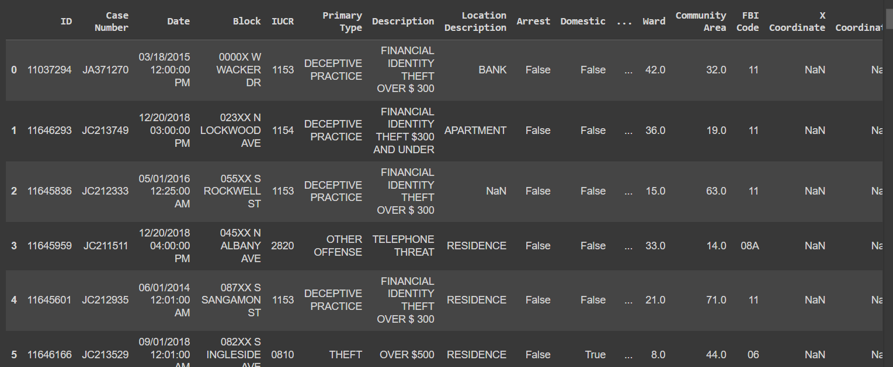
Source and visualization of dataset
https://data.cityofchicago.org/Public-Safety/Crimes-2001-to-Present/ijzp-q8t2/about_data

Slide 5
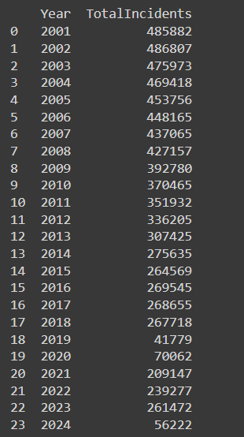
Total Number of Incidents by Year

Slide 6

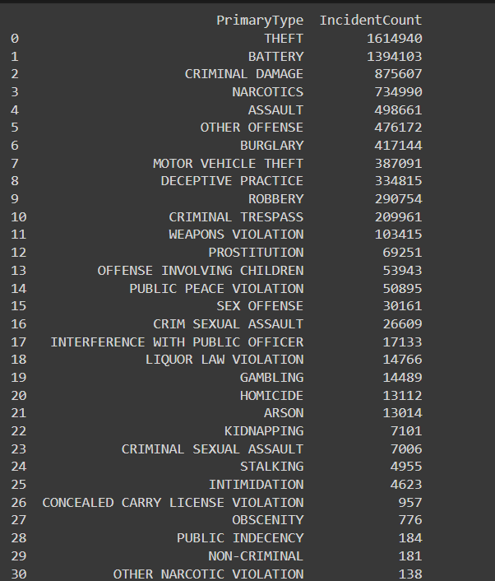
Distribution of Crime Types

Slide 7
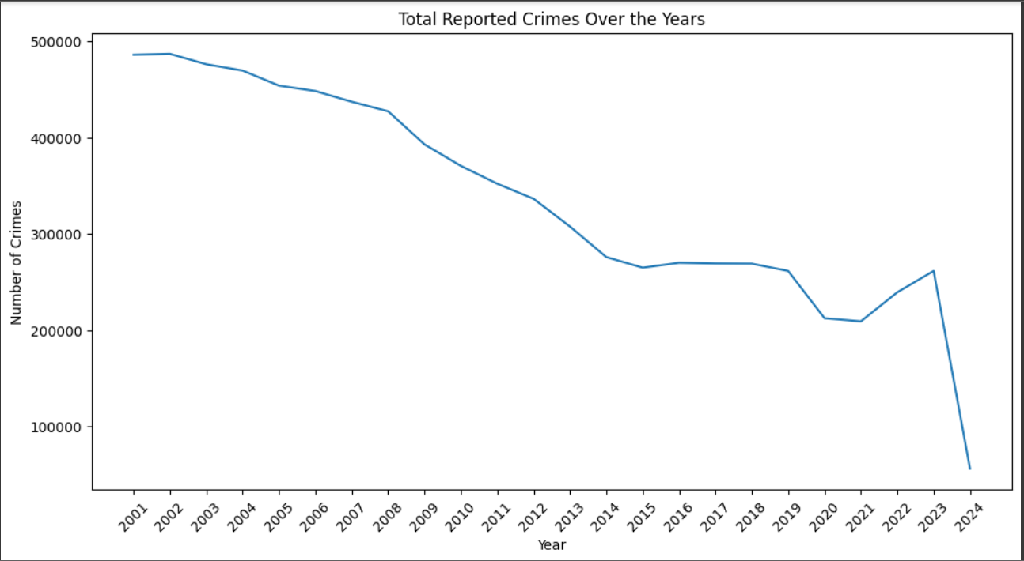

Crime Trends Over the Years

Slide 8

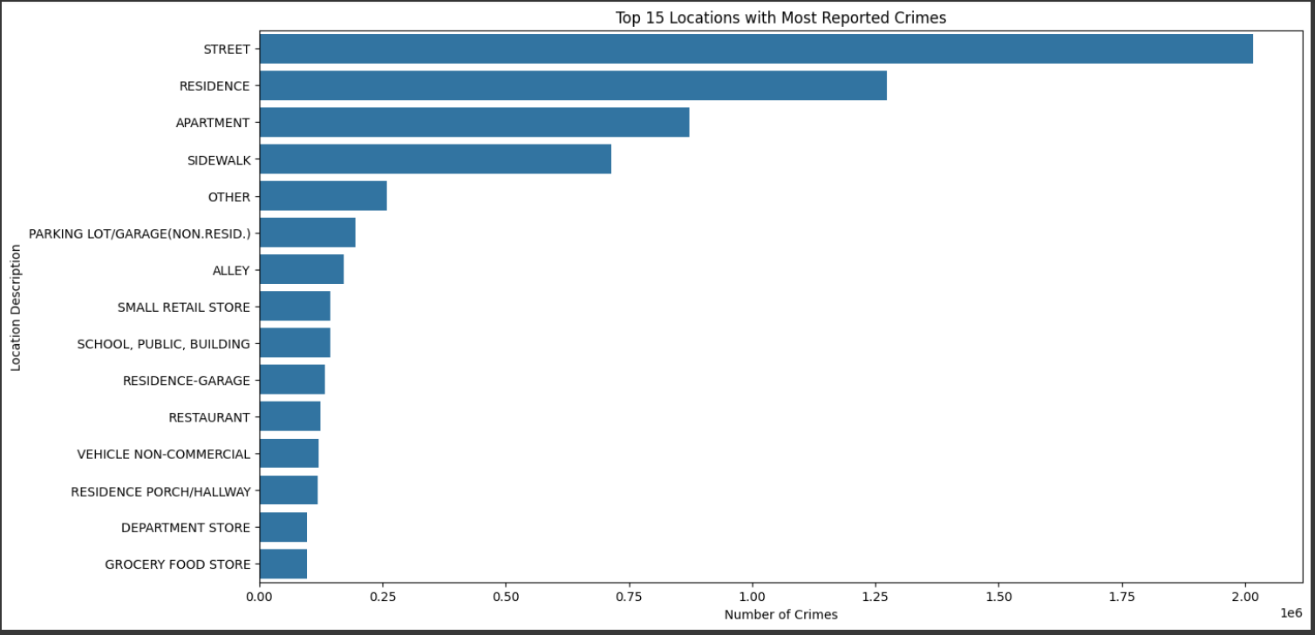
Crime Distribution by Location

Slide 9

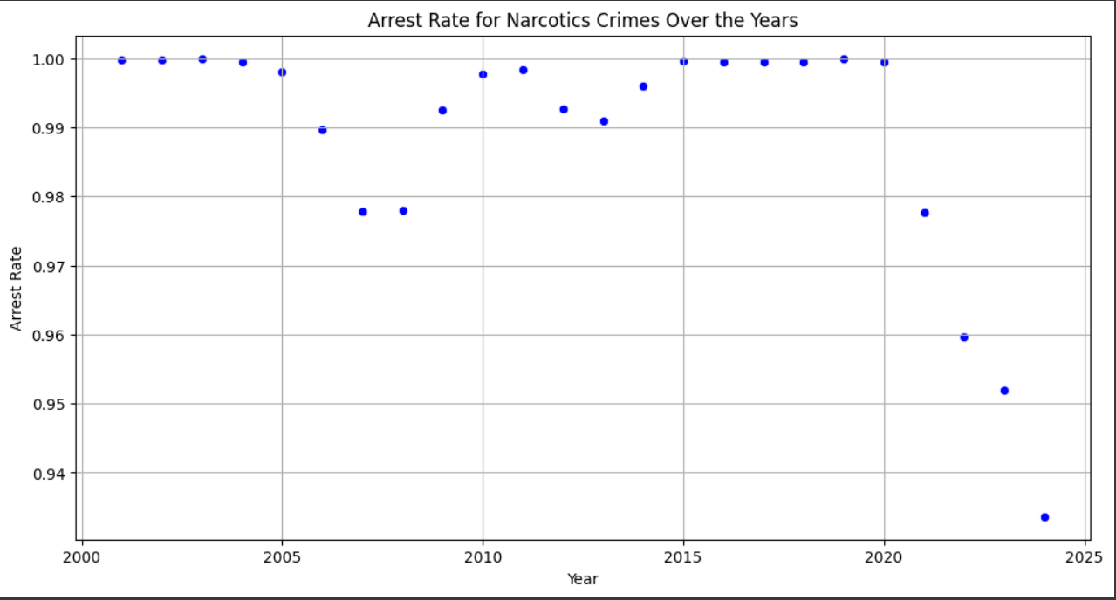
Arrest Rate for Narcotics Crimes Over the Years

Slide 10
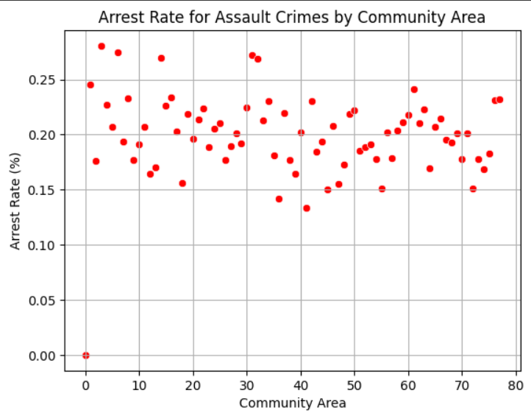
Arrest Rate for Assault Crimes by Community Area

Slide 11
conclusion
Comprehensive analysis revealed key patterns, trends, and correlations in Chicago's crime data.
Findings inform strategies for enhancing law enforcement, bolstering community safety, and addressing crime challenges.
Data-driven insights serve as a blueprint for crafting effective policies, interventions, and collaborative initiatives to reduce crime rates and foster resilient communities in Chicago.

Slide 12

THANK YOU

